Slide 1

Rock & Paper &Scissors Game
Presented by Ali Riza SEVGILI
(Workshop4 – Group1-Member 5)

Slide 2
Agenda
Introduction
The future of the program for users
What the program offers more utilities than other
Summary

Slide 3
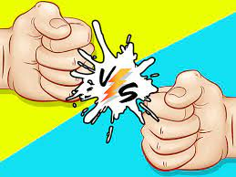
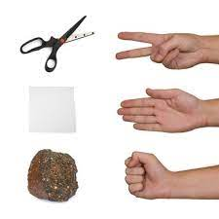
Introduction
Hello and welcome to the fun world of Rock-Paper Scissors! We are delighted to provide a digital version of this classic game, which is a kind of fun for players of all ages.
With a user-friendly and graphically appealing platform, we hope to spread the joy of this popular game to as many people as possible.
Our Rock-Paper-Scissors computer game has a number of essential features that make it a must-have for both serious gamers and casual players. As players strategize and compete against their virtual opponent, they will feel completely engaged.

Slide 4
Keep in mind that Rock-Paper-Scissors is a game that blends chance, strategy, and quick decision-making. The digital version is a fun and exciting way to compete with computer systems, put your brain to a game, or just have a little friendly competition.
Making a fist with your hand symbolizes the rock. Scissors are crushed by a rock, but paper triumphs.
An open hand is a shape for paper. Rock is covered with paper, which is cut with scissors.
The index and middle fingers are shown as scissor blades. Rock breaks scissors while cutting paper.
4. Or, if you're playing the digital version, start the game on your device.
If there is a tie and both players select the same hand motion, the round is repeated until a winner is established

Slide 5
We are proud to offer you with our state-of-the-art Rock-Paper-Scissors game, a technological marvel that blends exciting gameplay with fascinating characteristics that will keep you interested and entertained for hours on end.
Our game's user interface is one of its most appealing aspects because it is fluid and simple to use. A world of rock-crushing, paper-covering, and scissor-cutting action awaits you as soon as the game launches, welcoming you with breathtaking images and a modern design. The immersive experience we've created just for you will astound you, so get ready.
1
That's not all, though! With the animated countdown element in our game, each round is given a special twist that ups the excitement. Your excitement will grow as the seconds pass, making each choice more thrilling than the one before it. Can you perform at your best under pressure?
2
The excitement heightens as the countdown starts. From three to two and finally to one, you'll observe the numbers decreasing.
You have a decision to make during the countdown. Before the countdown approaches zero, will you choose your action swiftly from the available options?
You need to think quickly and take quick action increases with each passing second.
3
You have the option to begin a new game after each competition in our game. Would you like to rematch your opponent? Simply press the play button, and the heart-pounding action resumes, guaranteeing countless hours of friendly competition.
4

Slide 6
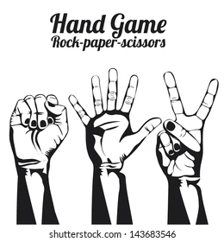
Summary
Long story short !
My program provides some thrilling features for users who want to have a fun via this game.
Experience the excitement of Rock-Paper-Scissors like never before. Step into the arena and show off your skills. Start a new game or revel in your previous victories.
With the final score counted and a champion crowned, the thrill of Rock-Paper-Scissors calls for another thrilling showdown. Will you rise to the challenge and claim victory once more? Prepare yourself for the next move and let the excitement begin!

Slide 7
Thank you
Ali Riza SEVGILI
Email address: arsevgili@myseneca.ca

